Slide 1
Week 11 PSLG SESSION
Hosted by: ben & Amy

Slide 2

DLSH

Slide 3
Agenda
Arrays

Slide 4
Arrays Explained:
An Array is equivalent to a container or a box for data of the same type.
E.g. a collection of integers :0,5,10,15 etc…
An array is statically sized. That means when you define its size you can’t change that or add more elements than its predefined size to it

Slide 5
Syntax
Name
N.B. Declares a new array is being made
Declares this is an Array
Declares the static size of the array
int[] array = new int[size]

Slide 6
Problem 1
Create a java class and a main method. Initialise an integer array of size 10. fill that array with random numbers {128 – 256} and print each element in the array to the terminal.
If you finish too quickly and want to add an extra challenge. Make the filling of the array into a method that is called in the main method.

Slide 7
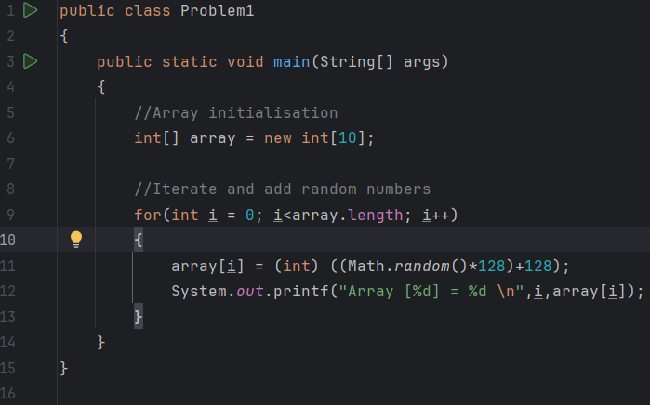
Solution

Slide 8
Useful array methods
Arrays have a ton of useful methods built into the class
Another example is:
Array.toString() which converts your entire array into a printable string.
(An example being the array.length method used in the for loop from the last question)

Slide 9
Problem 2
Create a class called problem 2 and create a main method. Create two arrays:
1. Contains letter Grades (F,D2,D1… A1)
2. Contains boundary Values (0,30,35… 80)
Generate a random number between one and 100, based on the number generated find the boundary value it falls between in the first array and print the Grade that represents that value.
Hint: The index of the boundary value represents the index of the grade,
It also is easier to do this if you make a method that returns a string to get the grade

Slide 10
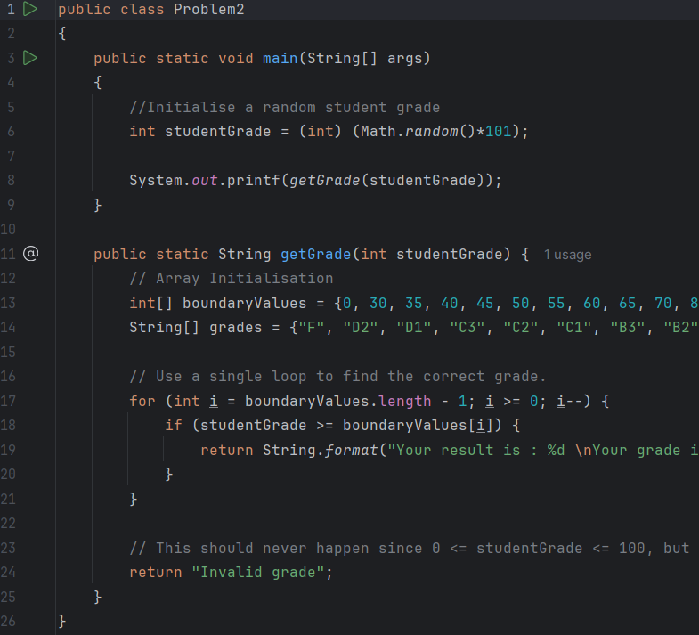
Solution

Slide 11
2D ARRAYS
2D arrays are an array that is 2 Dimensional.
This means the array has an X and Y axis in a sense.
The best way to visualise an array in ones head is to image an excel spreadsheet with rows and columns.

Slide 12
Syntax
Name
N.B. Declares a new array is being made
Declares this is an Array
Declares the static size of the array,for the rows and columns
int[][] array = new int[size1][size2]

Slide 13
Problem3
Create a java class called Problem 3. Create a main method in said class and initialise a 2D array of type integer with the name pascal triangle that generates a pascal triangle of any size between 3 and 5.
A pascal triangle is a triangle where every edge integer is 1 and any other integer on a row of the triangle is the sum of the two values above it.
E.g. 1
1 1
1 2 2 1
1 3 4 3 1

Slide 14
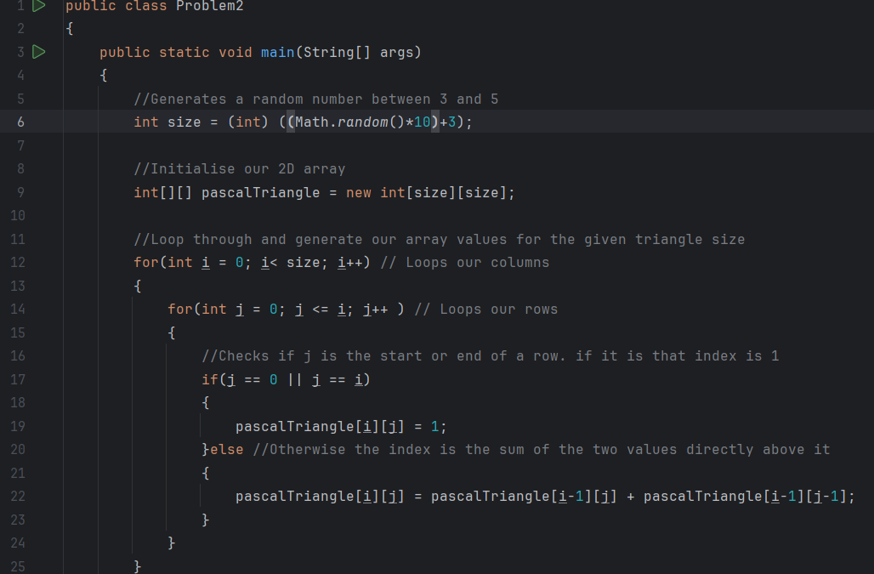
Solution P1: Generating the triangle

Slide 15
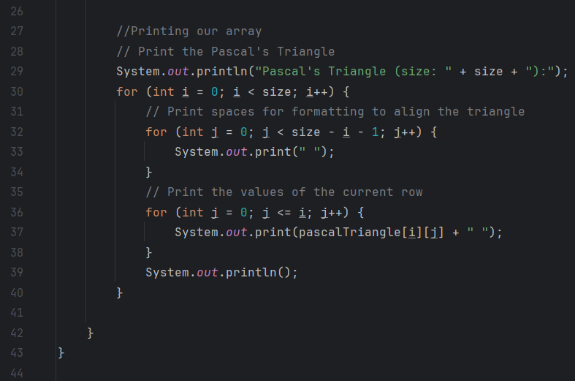
Solution P2: Printing the triangle

